Slide 1
II. Software Development Lifecycle
Designed by “Learning Academy” – An AWM TCOE Initiative

Slide 2
Topics
What is SDLC?
Waterfall
V Model
Incremental & Agile

Slide 3
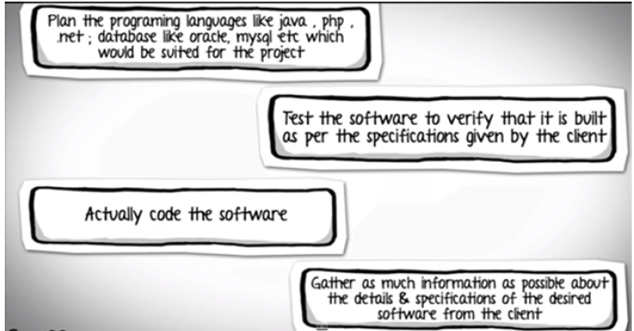
What is SDLC?

Slide 4
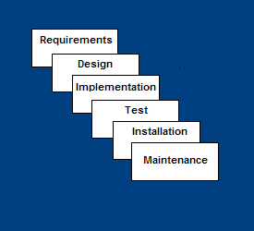
What is SDLC?
This sequence of activities to develop an application or software is nothing but SDLC.

Slide 5
Waterfall Model
Linear sequential design approach.
One should move to a phase only when its preceding phase is reviewed and verified.
Progress flows in largely one direction ("downwards" like a waterfall).

Slide 6
Limitations of Waterfall
All requirements must be known upfront
Deliverables created for each phase are considered frozen – lack of flexibility
Little opportunity for customer to preview the system (until it may be too late)
To address this concern, the V model was developed where for every phase, in the Development life cycle there is a corresponding Testing phase

Slide 7
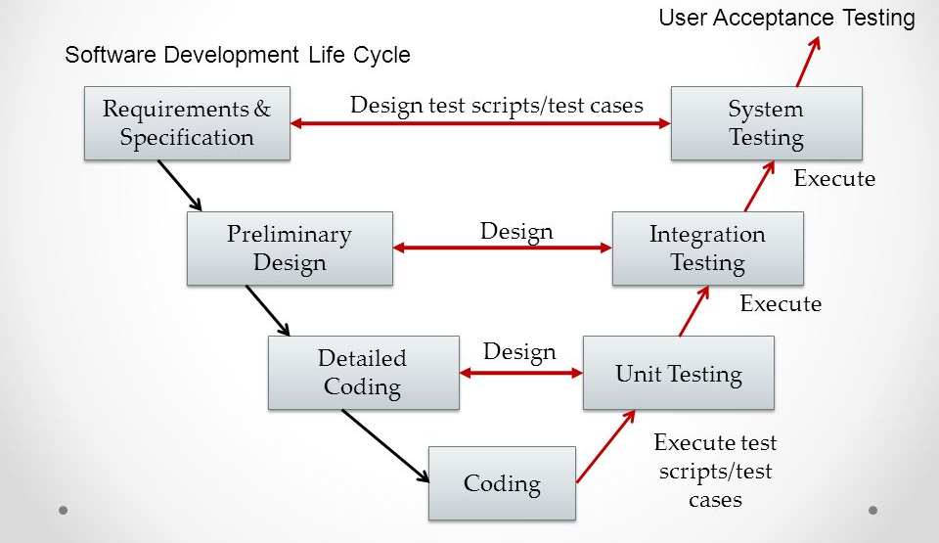
V-Shaped Model comes to the rescue
Testing of the product is planned in parallel with a corresponding phase of development.

Slide 8
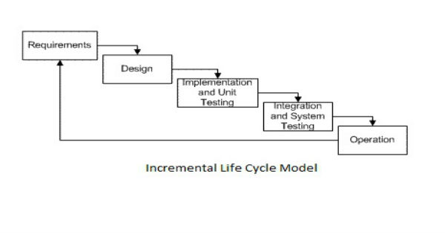
Incremental / Iterative SDLC Model
Application is not developed in one go but multiple iterations / increments.
Sub parts of the application are developed in each of these increments.

Slide 9
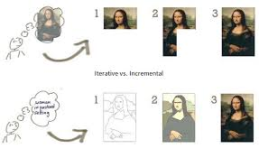
Incremental vs. Iterative SDLC Model- what differentiates them?

Slide 10
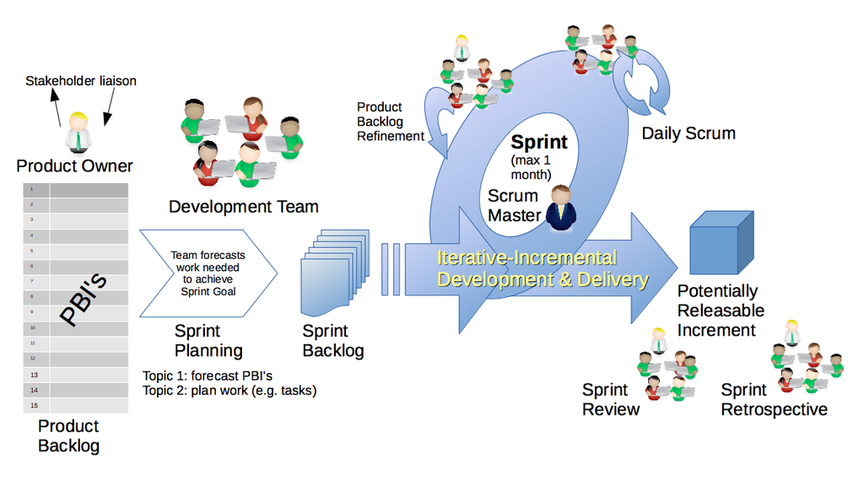
General workflow – Agile Methodology

Slide 11
Conclusion
There are numerous development life cycle models.
Development model selected for a project depends on the aims and goals of that project.
Testing is not a stand-alone activity, and it has to adapt the development model chosen for the project.

